Slide 1
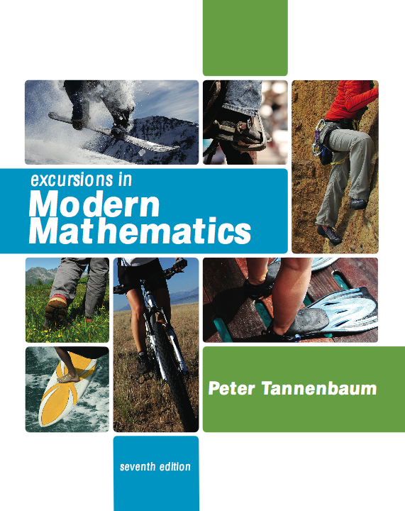

Slide 2
1 The Mathematics of Voting
1.1 Preference Ballots and Preference Schedules
1.2 The Plurality Method
1.3 The Borda Count Method
1.4 The Plurality-with-Elimination Method (Instant Runoff Voting)
1.5 The Method of Pairwise Comparisons
1.6 Rankings

Slide 3
The Method of Pairwise Comparison
Every candidate is matched head-to-head against every other candidate. Each of these head-to-head matches is called a pairwise comparison. In a pairwise comparison between X and Y every vote is assigned to either X or Y, the vote going to whichever of the two candidates is listed higher on the ballot. The winner is the one with the most votes; if the two candidates split the votes equally, the pairwise comparison ends in a tie.

Slide 4
The Method of Pairwise Comparison
The winner of the pairwise comparison gets 1 point and the loser gets none; in case of a tie each candidate gets 1/2 point. The winner of the election is the candidate with the most points after all the pairwise comparisons are tabulated.
(Overall point ties are common under this method, and, as with other methods, the tie is broken using a predetermined tie-breaking procedure or the tie can stand if multiple winners are allowed.)

Slide 5
Example 1.11 The Math Club Election (Pairwise Comparison)
We will illustrate the method of pairwise comparisons using the Math Club election. Let’s start with a pairwise comparison between A and B. For convenience we will think of A as the red candidate and B as the blue candidate - the other candidates do not come into the picture at all.

Slide 6
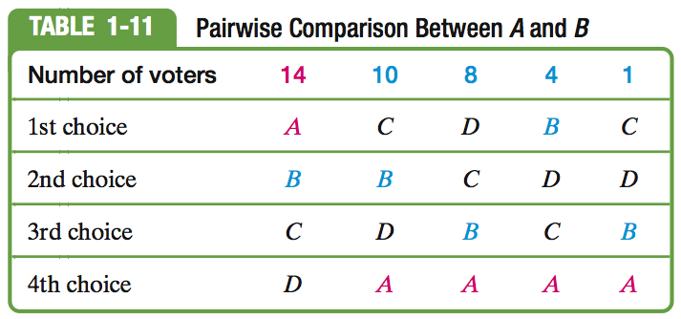
Example 1.11 The Math Club Election (Pairwise Comparison)

Slide 7
Example 1.11 The Math Club Election (Pairwise Comparison)
The first column of Table 1-11 represents 14 red voters (they rank A above B); the last four columns of Table 1-11 represent 23 blue voters (they rank B above A). Consequently, the winner is the blue candidate B. We summarize this result as follows:
A versus B: 14 votes to 23 votes (B wins)
B gets 1 point.

Slide 8
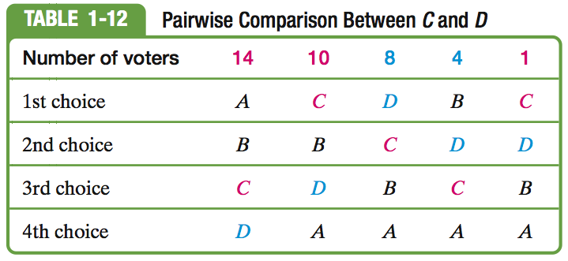
Example 1.11 The Math Club Election (Pairwise Comparison)

Slide 9
Example 1.11 The Math Club Election (Pairwise Comparison)
The first, second, and last columns of
Table 1-12 represent red votes
(they rank C above D);
the third and fourth columns represent blue votes (they rank D above C).
Here red beats blue 25 to 12.
C vs D: 25 to12 votes (C wins) C gets 1 point

Slide 10
Example 1.11 The Math Club Election (Pairwise Comparison)
Comparing in all possible ways two candidates at a time, we end up with the following scoreboard:
A vs B: 14 to 23 votes (B wins) B gets 1 point
A vs C: 14 to 23 votes (C wins) C gets 1 point
A vs D: 14 to 23 votes (D wins) D gets 1 point
B vs C: 18 to 19 votes (C wins) C gets 1 point
B vs D: 28 v to 9 votes (B wins) B gets 1 point
C vs D: 25 to 12 votes (C wins) C gets 1 point

Slide 11
Example 1.11 The Math Club Election (Pairwise Comparison)
The final tally produces 0 points for A, 2 points for B, 3 points for C, and 1 point for D. Can it really be true? Yes! The winner of the election under the method of pairwise comparisons is Carmen!
The method of pairwise comparisons satisfies all three of the fairness criteria discussed so far in the chapter.

Slide 12
What’s wrong with the Method of Pairwise Comparison?
So far, the method of pairwise comparisons looks like the best method we have, at least in the sense that it satisfies the three fairness criteria we have studied. Unfortunately, the method does violate a fourth fairness criterion. Our next example illustrates the problem.

Slide 13
Example 1.12 The NFL Draft
As the newest expansion team in the NFL, the Los Angeles LAXers will be getting the number-one pick in the upcoming draft. After narrowing the list of candidates to five players (Allen, Byers, Castillo, Dixon, and Evans), the coaches and team executives meet to discuss the candidates and eventually choose the team’s first pick on the draft. By team rules, the choice must be made using the method of pairwise comparisons. Table 1-13 shows the preference schedule after the 22 voters (coaches, scouts, and team executives) turn in their preference ballots.

Slide 14
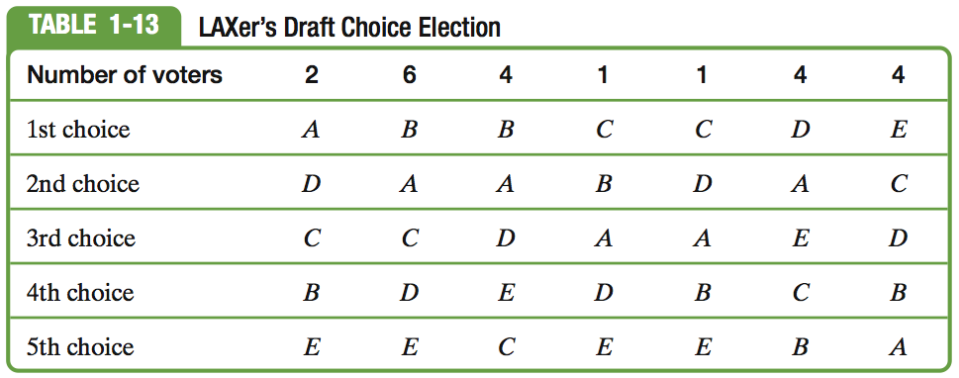
Example 1.12 The NFL Draft
The results of the 10 pairwise comparisons between the five candidates are:
A vs B: 7 to 15 votes, B gets 1 point
A vs C: 16 to 6 votes, A gets 1 point

Slide 15
Example 1.12 The NFL Draft
A vs D: 13 to 9 votes A gets 1 point
A vs E: 18 to 4 votes A gets 1 point
B vs C: 10 to 12 votes C gets 1 point
B vs D: 11 to 11 votes B & D get 1/2 point
B vs E: 14 to 8 votes B gets 1 point
C vs D: 12 to 10 votes C gets 1 point
C vs E: 10 to 12 votes E gets 1 point
D vs E: 18 votes to 4 votes D gets 1 point

Slide 16
Example 1.12 The NFL Draft
The final tally produces 3 points for A, 2 1/2 points for B, 2 points for C, 1 1/2 points for D, and 1 point for E.
It looks as if Allen (A) is the lucky young man who will make millions of dollars playing for the Los Angeles LAXers.

Slide 17
Example 1.12 The NFL Draft
The interesting twist to the story surfaces when it is discovered right before the actual draft that Castillo had accepted a scholarship to go to medical school and will not be playing professional football. Since Castillo was not the top choice, the fact that he is choosing med school over pro football should not affect the fact that Allen is the number-one draft choice. Does it?

Slide 18
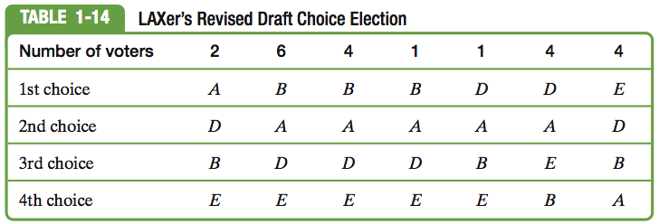
Example 1.12 The NFL Draft
Suppose we eliminate Castillo from the original preference schedule (we can do this by eliminating C from Table 1-13 and moving the players below C up one slot). Table 1-14 shows the results of the revised election when Castillo is not a candidate.

Slide 19
Example 1.12 The NFL Draft
Now we have only four players and six pairwise comparisons to consider.
The results are as follows:
A vs B: 7 to 15 votes B gets 1 point
A vs D: 13 to 9 votes A gets 1 point
A vs E: 18 to 4 votes A gets 1 point
B vs D: 11 to 11 votes B & D get 1/2 point
B vs E: 14 to 8 votes B gets 1 point
D vs E: 18 to 4 votes D gets 1 point

Slide 20
Example 1.12 The NFL Draft
In this new scenario: 2 points for A, 2 1/2 points for B, 1 1/2 points for D, and 0 points for E, and the winner is Byers. In other words,when Castillo is not in the running, then the number-one pick is Byers, not Allen. Needless to say, the coaching staff is quite perplexed.
Do they draft Byers or Allen? How can the presence or absence of Castillo in the candidate pool be relevant to this decision?

Slide 21
Example 1.12 The NFL Draft
The strange happenings in Example 1.12 help illustrate an important fact: The method of pairwise comparisons violates a fairness criterion known as the independence-of-irrelevant-alternatives criterion.

Slide 22
The Independence-of-Irrelevant-Alternatives Criterion
THE INDEPENDENCE-OF-IRRELEVANT-ALTERNATIVES CRITERION (IIA)
If candidate X is a winner of an election and in a recount one of the nonwinning candidates withdraws or is disqualified, then X should still be a winner of the election.

Slide 23
Alternative Interpretation: Independence-of-Irrelevant-Alternatives Criterion
Switch the order of the two elections (think of the recount as the original election and the original election as the recount). Under this interpretation, the IIA says that if candidate X is a winner of an election and in a reelection another candidate that has no chance of winning (an “irrelevant alternative”) enters the race, then X should still be the winner of the election.

Slide 24
How Many Pairwise Comparisons?
One practical difficulty with the method of pairwise comparisons is that as the number of candidates grows, the number of comparisons grows even faster.
5 candidates we have a total of 10 pairwise comparisons
10 candidates we have a total of 45 pairwise comparisons
100 candidates we have a total of 4950 pairwise comparisons

Slide 25
Two Formulas that Help
SUM OF CONSECUTIVE
INTEGERS FORMULA
THE NUMBER OF PAIRWISE COMPARISONS
In an election with N candidates the total number of pairwise comparisons is

Slide 26
Example 1.16 Scheduling a Round-Robin Tournament
Every player (team) plays every other player (team) once. Imagine you are in charge of scheduling a round-robin Ping-Pong tournament with 32 players. The tournament organizers agree to pay you $1 per match for running the tournament - you want to know how much you are going to make. Since each match is like a pairwise comparison, we can use the formula. We can conclude that there will be a total of (31•32)/2 = 496 matches played. Not a bad gig for a weekend job!

